Slide 1

Covid-19 Prediction Using
Chest X-ray Images
Final Project Presentation On
June 4, 2021
Presented By
Abhishek Kumar - 001
Nitin Sharma - 017
Presented To
Dr. Dinesh Naik

Slide 2

AGENDA
ABSTRACT
INTRODUCTION
DATASET AND WORKING ENVIRONMENT
PROBLEM STATEMENT AND OBJECTIVES
METHODOLOGY and MODEL DETAILS
RESULTS
COMPARISON WITH PAPER
CONCLUSION AND FUTURE WORK
CONTRIBUTION

Slide 3
ABSTRACT
GOAL is to perform transfer learning using deep learning models like Resnet50 and VGG16 and compare their performance with a newly developed CNN based model.
Resnet50 and VGG16 are state-of-the-art models and have been used extensively in Computer vision tasks. A comparative analysis with them will give us an idea of how good our model is.
We will be developing a CNN model as it is expected to perform good on image classification related problems.

Slide 4
INTRODUCTION
Understanding COVID-19 became very important since large scale vaccination of it is still not possible. Chest X-ray is the first imaging technique that plays an important role in the diagnosis of COVID-19 disease.
Till now in various fields, great success has been achieved using convolutional neural networks(CNNs) for image recognition and classification.
However, due to the limited availability of annotated medical images, the classification of medical images remains the biggest challenge in medical diagnosis.
Here, we work on some models for the classification of COVID-19 chest X-ray.

Slide 5
INTRODUCTION
Convolutional neural networks are extensively been used in image classification, object detection, segmentation task etc and our problem i.e.
Covid-19 identification using chest x-ray is also a type of image classification as chest x-ray images will be given to CNN models and they have to categorise that image into two classes i.e. either diagnosed with covid or normal.
There already are various state of the art models like VGG-16, Resnet-50 etc for these kinds of tasks. We have picked VGG-16 and Resnet-50 for our work.
We have also developed our own CNN model and then did comparative analysis of all three models over 2 different dataset.

Slide 6
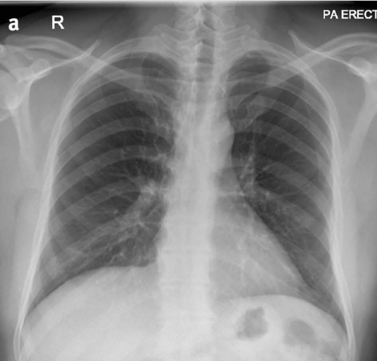
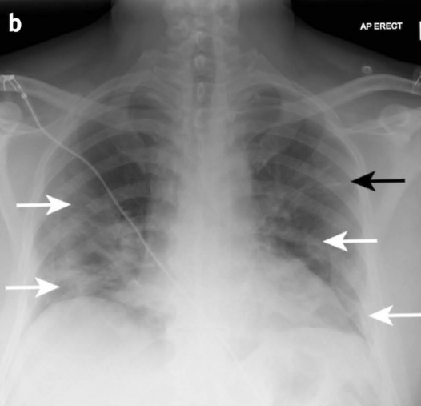
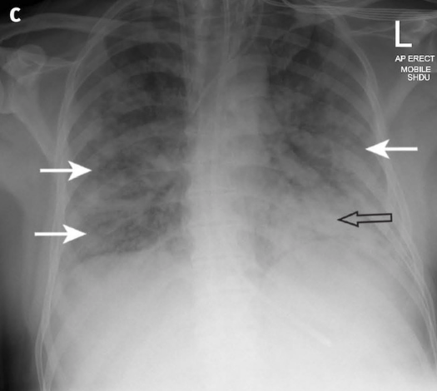
UNDERSTANDING X-RAYS
(12 months before admission)
(Day 0 of admission)
(Day 10 of admission)
Normal vs COVID-19 Patient Xray

Slide 7


DATASET AND WORKING ENVT.
Covid-19 Dataset
System Setup
Total Size : ~800MB
Total Image Files : ~14000
Normal Image Files : ~10500
COVID-19 Image Files : ~3500
Current Tested : 2400
2000 Train (1000 each)
400 Test (200 each)
Google-colab environment
Covid-19 Radiography dataset from Kaggle
Language : Python
Libraries - Keras, pandas,numpy,matplotlib etc.

Slide 8
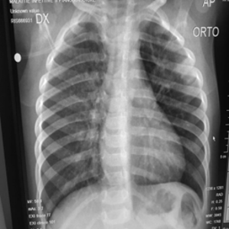
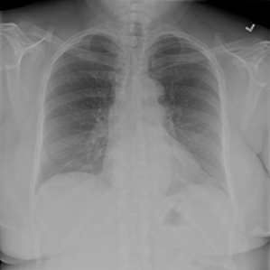
PROBLEM : With Dataset 1
: Covid Image
Normal Image :
Problem with covid chest xray datasets

Slide 9
DATASET INSIGHT
Kaggle Radiography Dataset: It is a publically available chest x-ray image dataset in which total 14000 chest x-ray images belongs to four different classes i.e. COVID-19 Lung Opacity, Normal and Viral pneumonia. But for our case we have taken 2000 images belonging to two classes i.e. COVID-19 and Normal for training and 400 images for testing.
Own prepared dataset : We have taken COVID-19 diagnosed chest x-ray images from GitHub and Normal chest x-ray images data from Kaggle and by merging these two we prepared another dataset. Here there are 340 chest x-ray images in total which further split as 220 for training and 120 for testing.

Slide 10
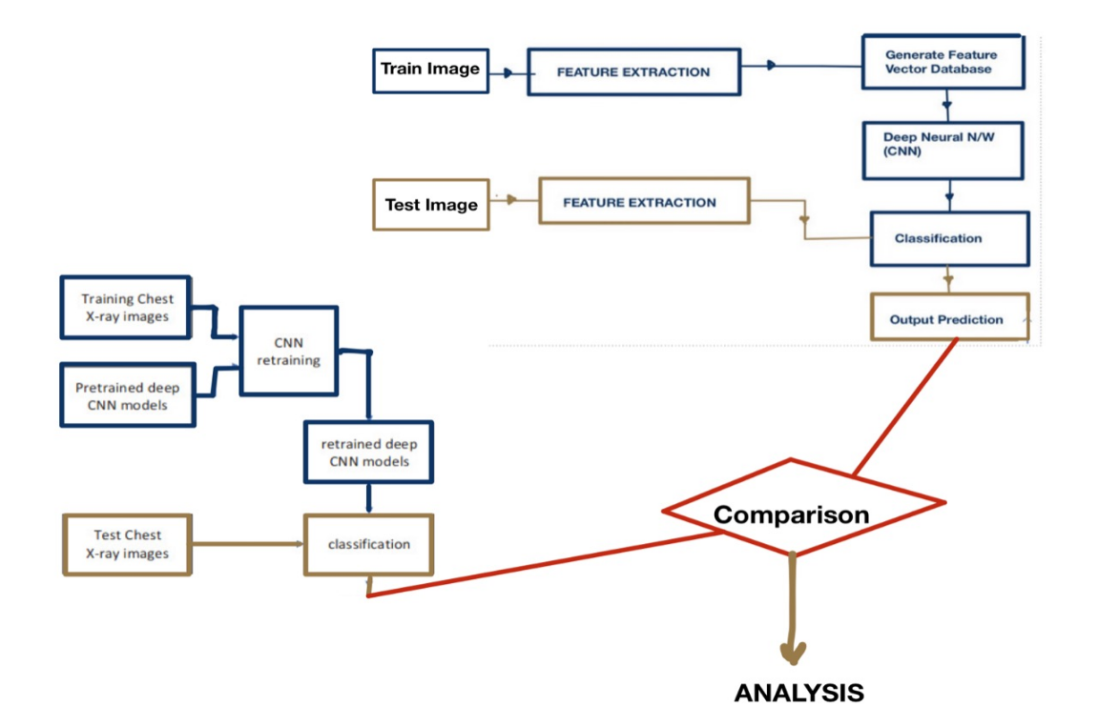
METHODOLOGY

Slide 11
TRANSFER LEARNING
Transfer learning (TL) is a research problem in machine learning (ML) that focuses on storing knowledge gained while solving one problem and applying it to a different but related problem.
If we think carefully then we find that it is a human tendency to to generalize the things like use the learnings of one problem to other similar kind of problem.
Real life example - Using leanings of solving a percentage problem to other percentage problem of similar kind, Re-training our mind to learn other object-oriented-programming language if we have already learned a similar one.
Other Examples - knowledge gained while learning to recognize cars could apply when trying to recognize trucks etc.

Slide 12
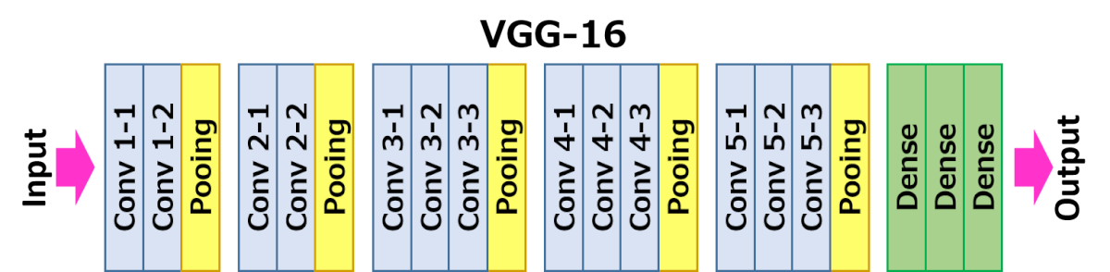
MODEL : VGG-16 ARCHITECTURE
VGG16 is a CNN architecture which was used to win Imagenet competition in 2014.
The 16 in VGG16 refers to it has 16 layers that have weights. This network is a pretty large network and it has about 138 million (approx) parameters.

Slide 13
MODEL : VGG-16 ARCHITECTURE
Most unique thing about VGG16 is that they focused on having convolution layers of 3x3 filter with a stride 1 and always used same padding and maxpool layer of 2x2 filter of stride 2.
It follows this arrangement of convolution and max pool layers consistently throughout the whole architecture.
In the end it has 2 FC(fully connected layers) with 4096 neurons each followed by a softmax for output as we are doing binary classification.
We are using sigmoid instead as ours is a binary classification problem.

Slide 14
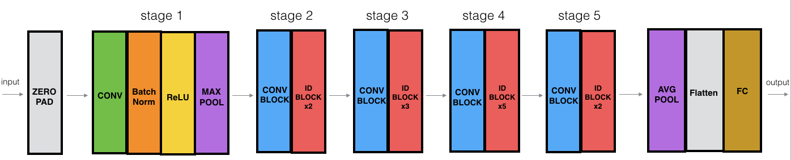
MODEL : RESNET-50 ARCHITECTURE
ResNet, short for Residual Networks is a classic neural network used as a backbone for many computer vision tasks.
This model was the winner of ImageNet challenge in 2015.

Slide 15
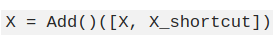
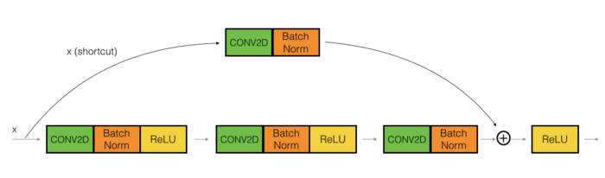
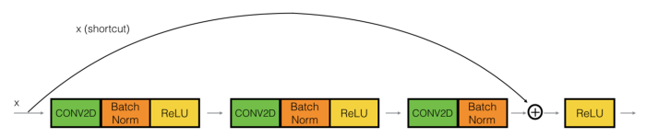
MODEL : RESNET-50 ARCHITECTURE
Skip Connections to resolve vanishing gradient

Slide 16
MODEL : OUR CNN ARCHITECTURE
We have created our own CNN model having four blocks. In the first block we have two convolution layer with 32 and 64 respectively kernels of size 3*3 and after that we have a max pooling layer with pool size as 2*2.
First layer, in all blocks other than last block, we have a single Convolution layer with 64 or 128 filters and filter size as 3*3 and then a max pooling layer with pool size as 2*2.
In the last block we have two dense layers and at the last layer we have sigmoid as activation function because we have to do the binary classification. We also added a dropout layer with value 0.25 or 0.5 in each block.

Slide 17
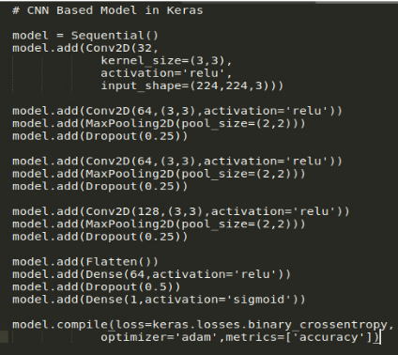
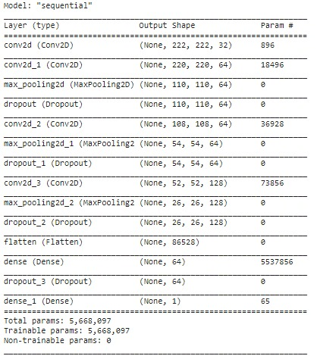
MODEL : OUR CNN ARCHITECTURE

Slide 18
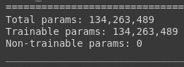
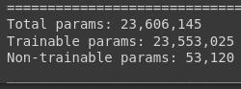
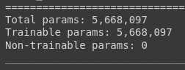
MODEL : PARAMETERS
VGG16 :
RESNET50 :
Our Model :
It can be seen here that number of parameters in our model is significantly less when compared to other two deep neural network models

Slide 19

WORK PERFORMED
We retrained the VGG-16 model on the two dataset (which we already mentioned in the dataset section) and noted down all the results that we got.
We retrained the Resnet-50 model on the two dataset(which we already mentioned in the dataset section) and noted down all the results.
We build our own CNN model from the scratch, did parameter tuning and noted down the results after testing.
Finally, we did a comparative study of all these model and find out that which

Slide 20
RESULT : Dataset 1
Model | Train accuracy % | Validation accuracy % | Test accuracy %
Vgg16 (Dataset 1) | 51 | 48 | 50
Resnet50 (Dataset 1) | 95.4 | 64.06 | 64.25
Our Model (Dataset 1) | 78.29 | 73 | 69.82
Our model seems to out-perform other models.
Test accuracy for Vgg-16 model is very low.
In case of Resnet-50, we can see that there is overfitting.

Slide 21
RESULT : Dataset 2
Model | Train accuracy % | Validation accuracy % | Test accuracy %
Vgg16 (Dataset 2) | 94 | 93 | 87.5
Resnet50 (Dataset 2) | 94.99 | 99 | 93.7
Our Model (Dataset 2) | 96.3 | 96.8 | 96.67
Our model seems to out-performed other models.
Test accuracy for Vgg-16 model is very low.

Slide 22
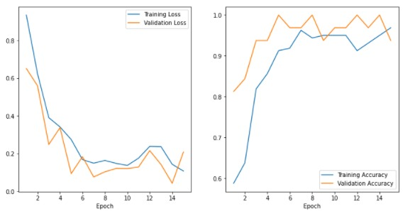
RESULT : Dataset 2
Plot shows that there is no over-fitting or under-fitting in this case for our model.

Slide 23
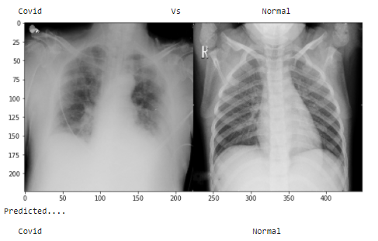
SAMPLE PREDICTIONS : correct

Slide 24
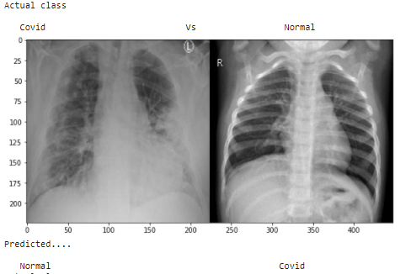
SAMPLE PREDICTIONS : incorrect

Slide 25
COMPARISON WITH PAPER
Model | Test Accuracy of paper
Vgg16 (Paper) | 92.67, 95.56, 94.31
Resnet50 (Paper) | 99.52, 96.88, 100
Our Model | 96.67
Our model performed better than their VGG-16 model.
Their Resnet-50 model outperformed our all configurations.

Slide 26
CONCLUSION
In our work, we worked on binary classification of chest x-ray of patients into COVID-19 affected or normal classes. For this we worked on two datasets. Dataset 1 was a Radiography dataset taken directly from Kaggle and dataset 2 was a mixture of multiple datasets.
We trained two state-of-the-art CNN based models, i.e. VGG-16 and Resnet-50. We also developed another CNN based model to do its comparative analysis with VGG-16 and Resnet-50 models.
In case of Dataset 1, We achieved the highest test accuracies in case of our CNN model. For VGG-16 accuracy was 50% and in case of Resnet-50 it was 64.25% which shows that our model out-performed these two.

Slide 27
CONCLUSION
In case of dataset 2, we achieved better accuracies than database 1 for all three models. The reason for this was that dataset 2 consisted of good quality images. We achieved the highest accuracy of 96.67% for our CNN model and 87.5% for VGG-16 and 93.7% for Resnet-50 model. This shows that our CNN model outperforms both of these models too.

Slide 28
CONTRIBUTION
Creating and testing of VGG-16 model.
Creation and testing of Resnet-50 model.
Develop a CNN model to do performance comparison with these state-of-the-art models.
Abhishek Kumar worked on 1 and 3 while Nitin Sharma worked on 2 and 3.

Slide 29
FUTURE WORK
A lot of new strain of viruses are coming out. COVID-19 virus is evolving and this is resulting in vaccines made for older virus become less effective for these.
Also, a recent study showed that we might get an evolved version of coronavirus around 2025. This makes it very important to only increase research in this field.
Our work can be expanded to classify these viruses into other classes too like pneumonia, etc.
Moreover, good quality dataset creation should be of high focus as if now as higher the availability of these datasets, better will be performance of our neural network models.

Slide 30
REFERENCES
COVID-19 Identification from Chest X-Rays : https://ieeexplore.ieee.org/document/9244509
Classification of COVID-19 in chest X-ray images using DeTraC deep convolutional neural network : https://link.springer.com/article/10.1007/s10489-020-01829-7
Automated detection of covid-19 cases using deep neural network with x-ray images : https://www.sciencedirect.com/science/article/abs/pii/S0010482520301621
A capsule-Network based framework for identification of covid-19 cases from x-ray images. : https://arxiv.org/pdf/2004.02696v2.pdf
Dataset 1 : https://www.kaggle.com/tawsifurrahman/covid19-radiography-database
Dataset 2 : https://github.com/ieee8023/covid-chestxray-dataset

Slide 31
THANK YOU!!!

